Slide 1

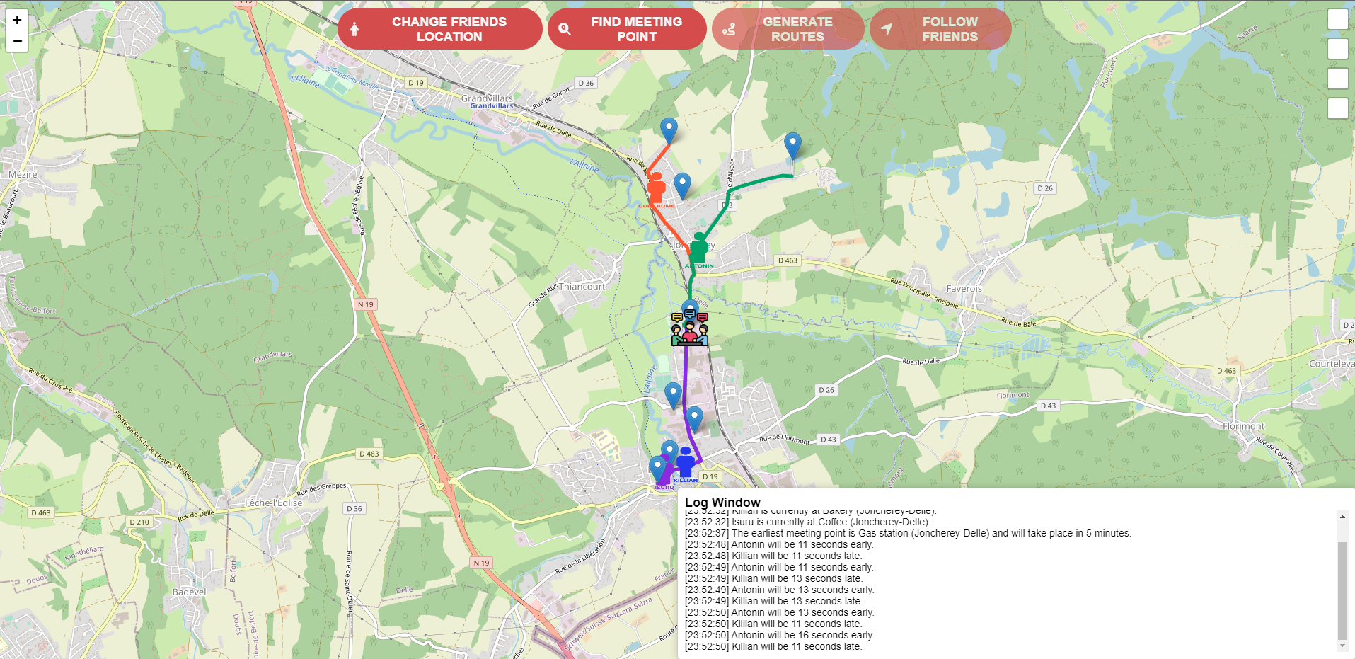
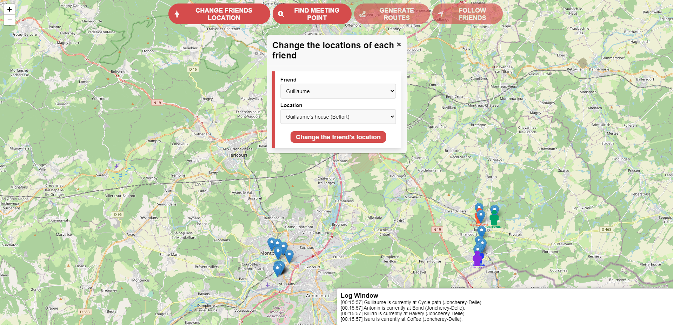
MSC PROJECT
Antonin WINTERSTEIN
Killian MAXEL
Teacher: Mr. Philippe CANALDA

Slide 2

PRESENTATION
Optimizing Student Meetups with Location-Based App
THE PROJECT
GOAL
Optimal Meetup Planning
Determine ideal meeting place and time window
Accounts for individual schedules and locations
Individual Route Generation
Create personalized routes for each friend
Real-Time Tracking
Monitor friends' progress to meetup location
Provide alerts for delays or advancements
Creating a Mobile/Web App mapping friend’s locations (home, university, parking...) using an Origin-Destination (OD) matrix for efficient group meetups
OD matrix with 30 locations: distances, time estimates, routes
Considering Belfort-Montbéliard environment
Registering friends for accurate positioning
Include roads for custom route generation and tracking
‹#›
Antonin Winterstein - Killian Maxel | MSC project | Master IoT 2023-2024
15

Slide 3
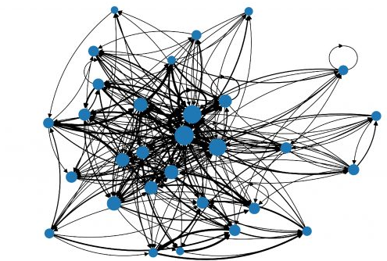
CONCEPTION

Slide 4
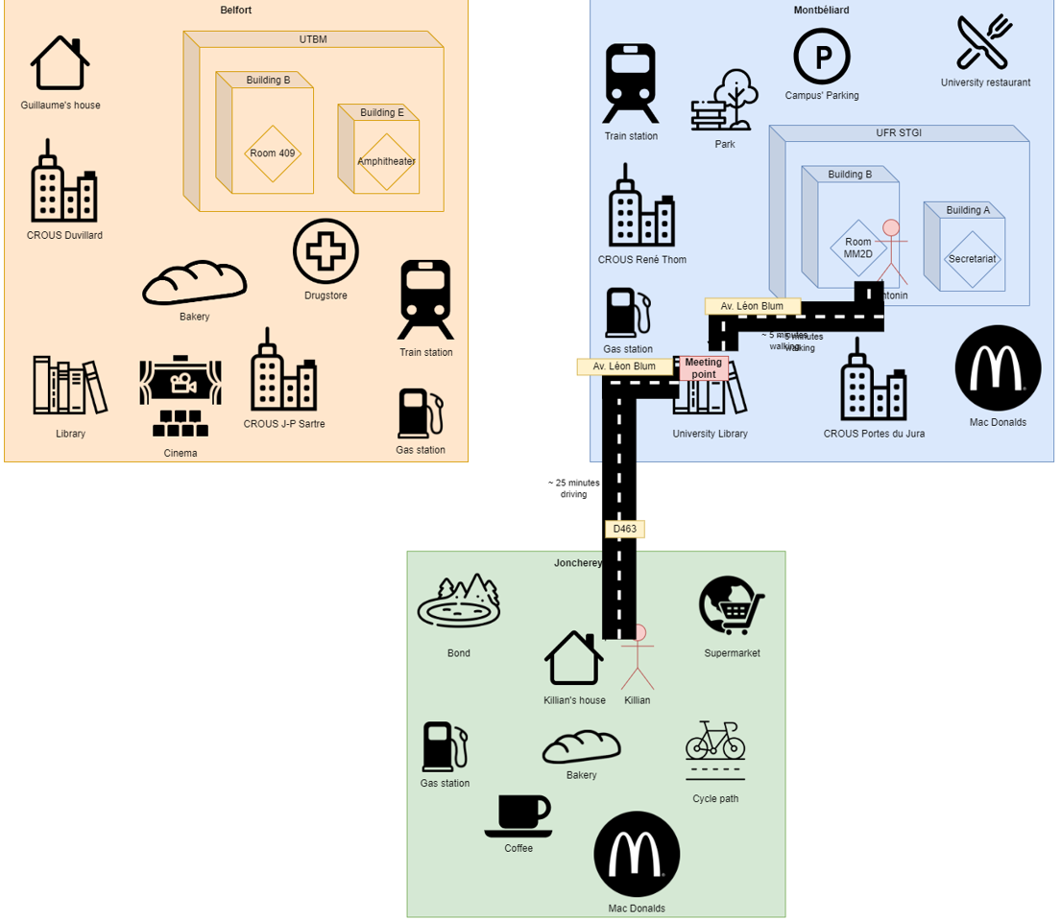
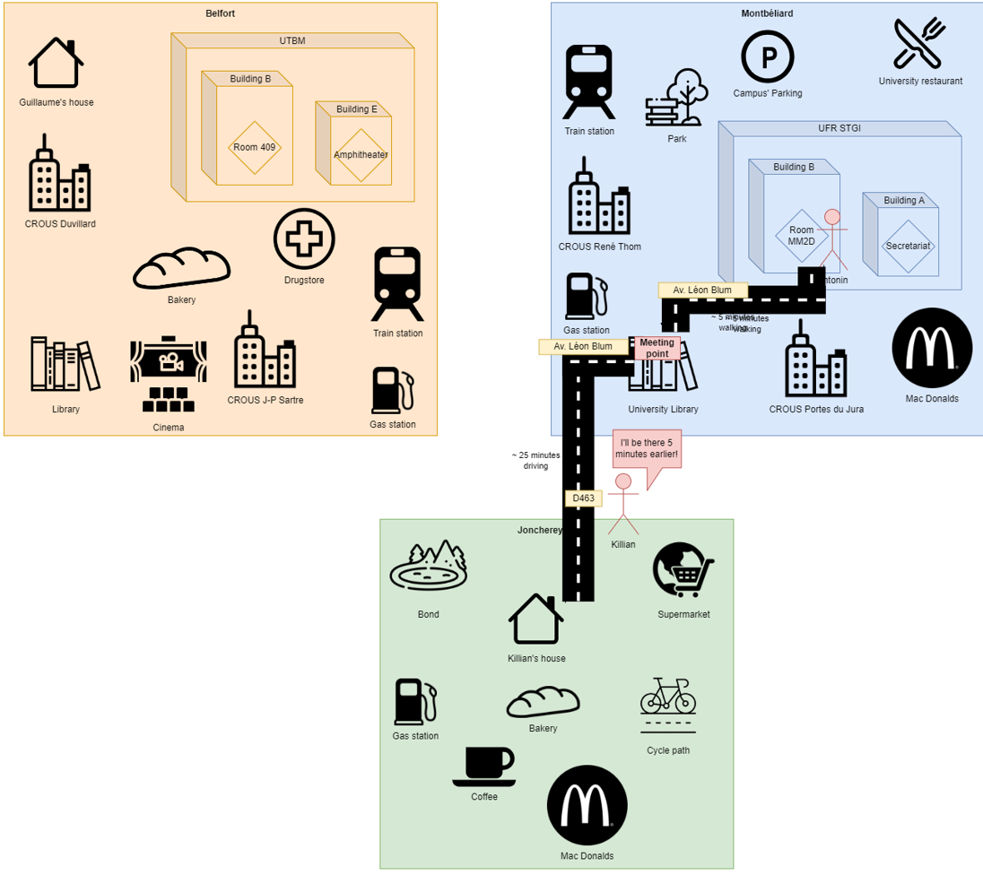
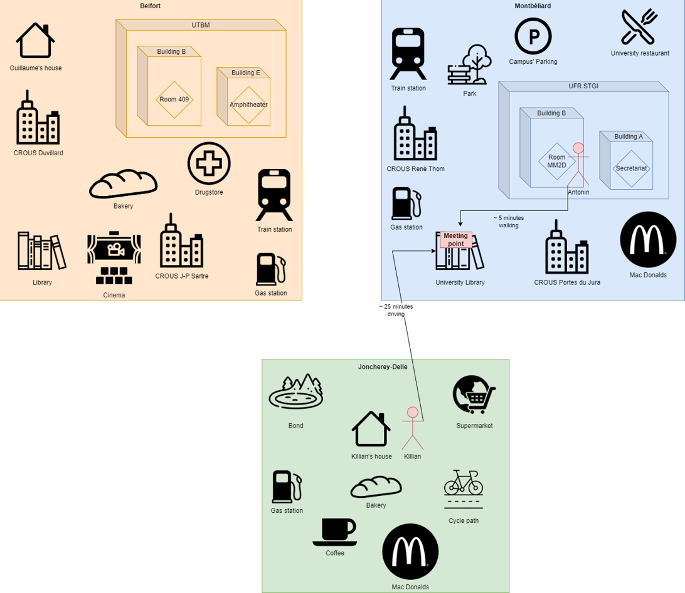
CONCEPTION DIAGRAM
ANALYSIS
‹#›
Antonin Winterstein - Killian Maxel | MSC project | Master IoT 2023-2024
15

Slide 5
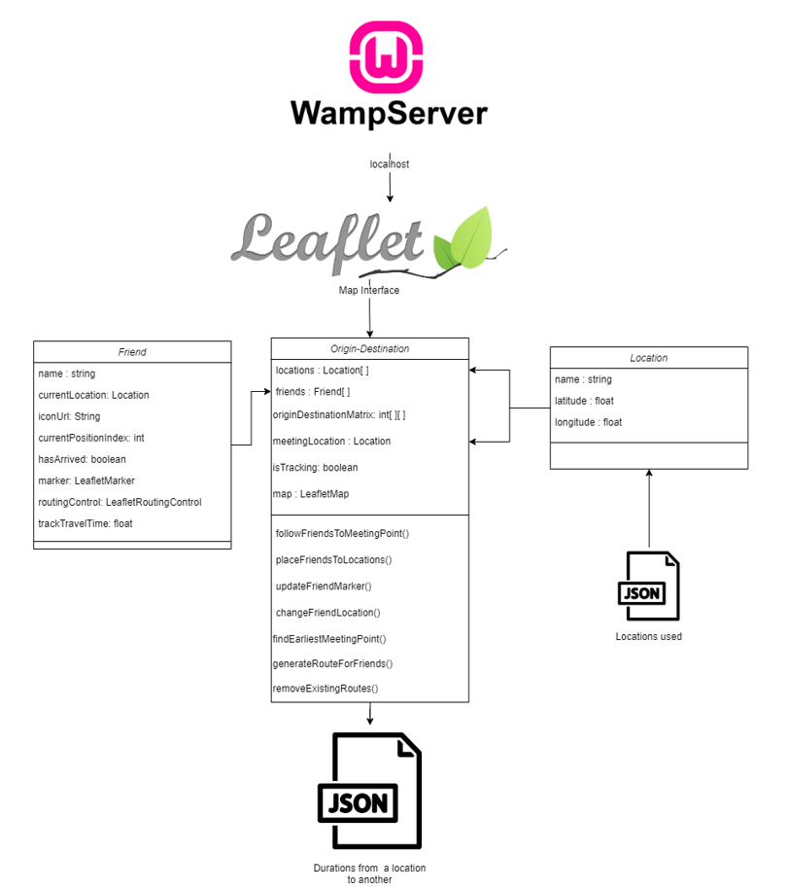
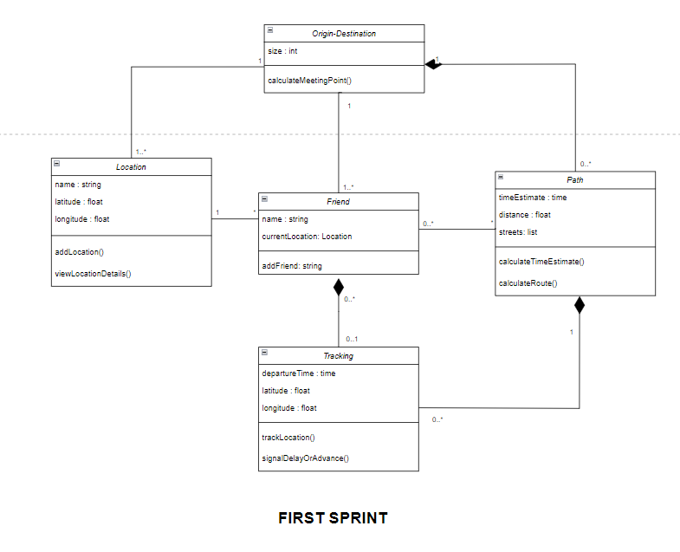
CLASS DIAGRAM
ANALYSIS
‹#›
Antonin Winterstein - Killian Maxel | MSC project | Master IoT 2023-2024
15
Notes:
Killian (key)

Slide 6
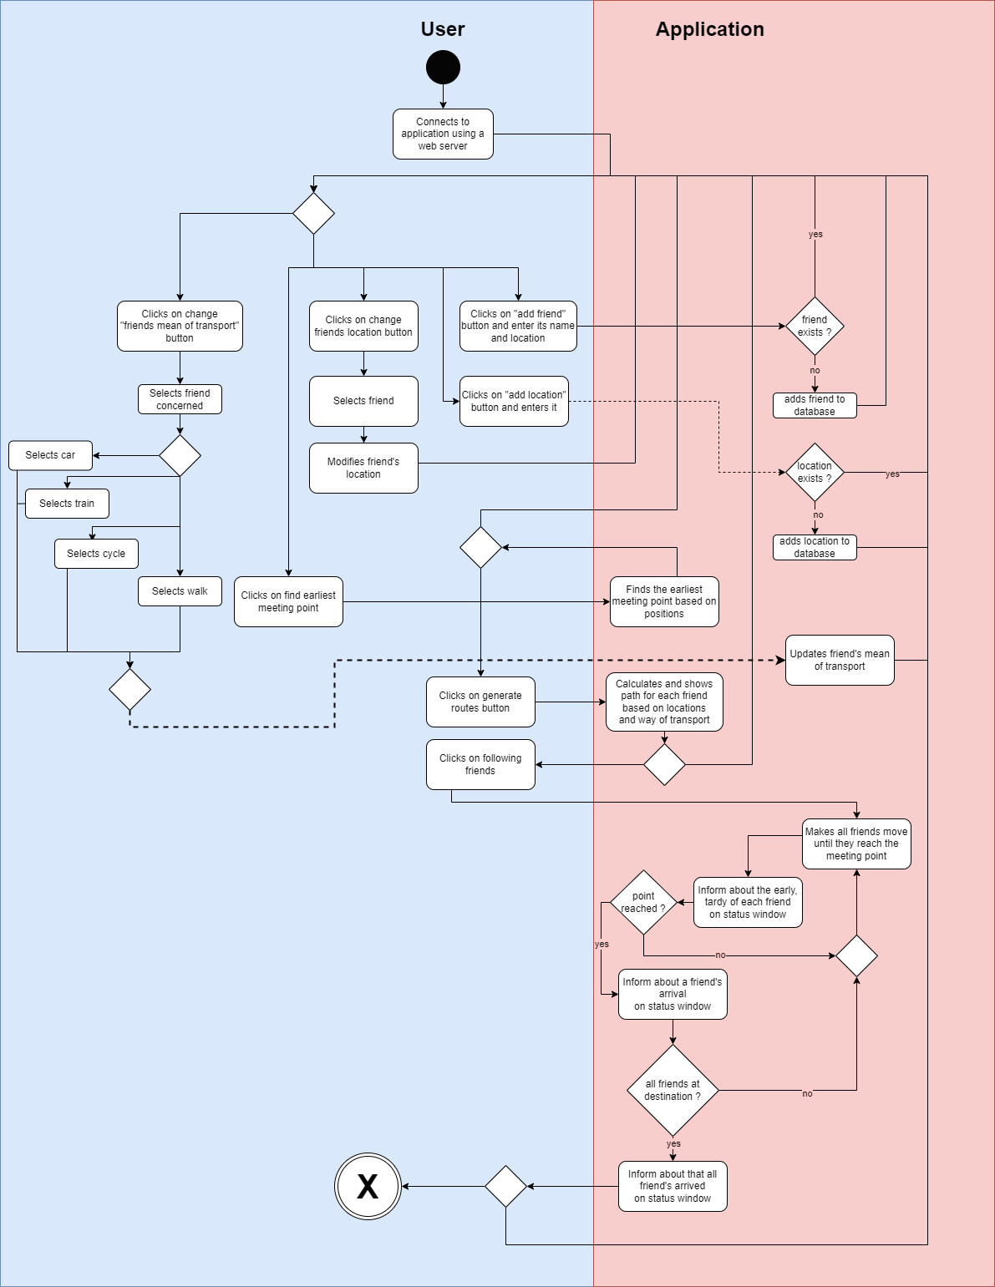
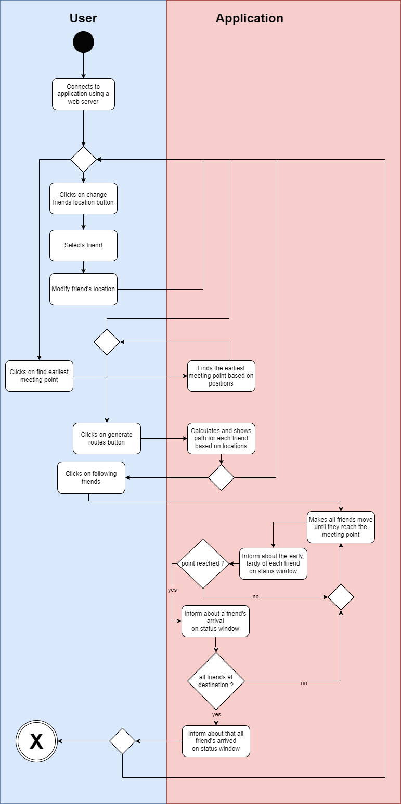
ACTIVITY DIAGRAM
ANALYSIS
‹#›
Antonin Winterstein - Killian Maxel | MSC project | Master IoT 2023-2024
15
Notes:
Killian (key)

Slide 7
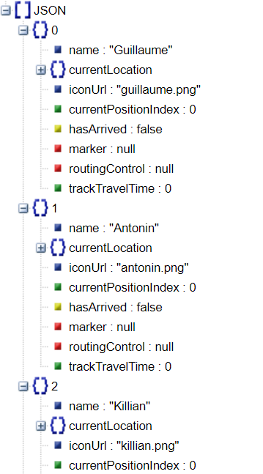
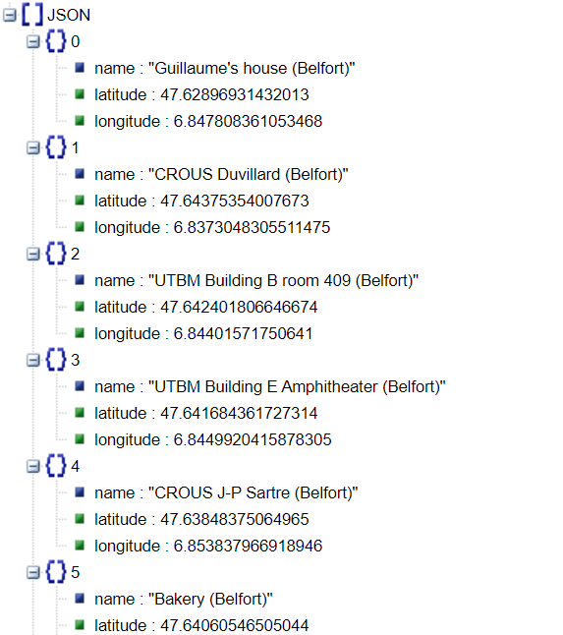
Friends
Locations
JSON FILES
RESULT
‹#›
Antonin Winterstein - Killian Maxel | MSC project | Master IoT 2023-2024
15

Slide 8
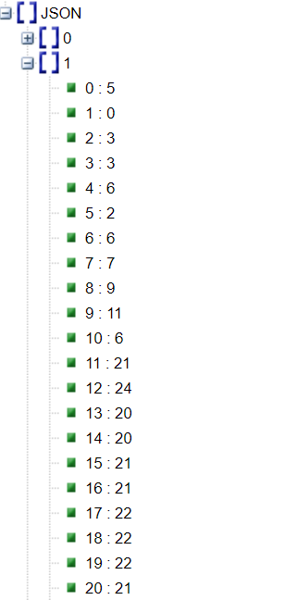
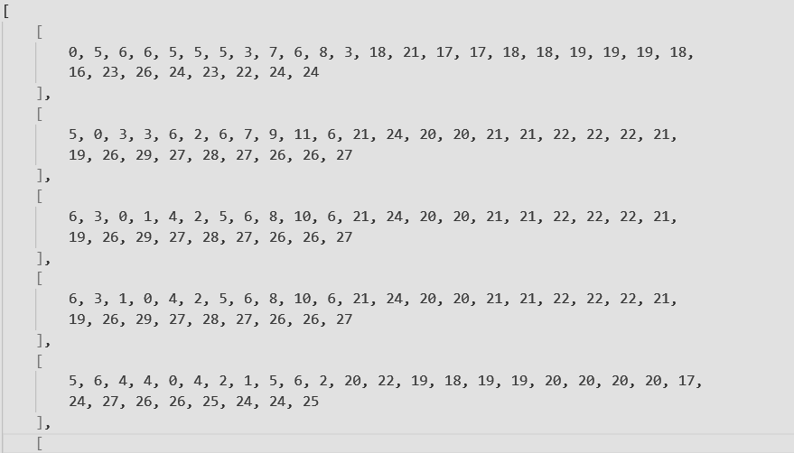
JSON FILES - ORIGIN DESTINATION MATRIX
RESULT
Each value is the duration to go from point A to point B
(if A=B then 0) (same value from point B to point A)
matrix symmetry, reflexivity and transitivity are checked at launch
‹#›
Antonin Winterstein - Killian Maxel | MSC project | Master IoT 2023-2024
15

Slide 9
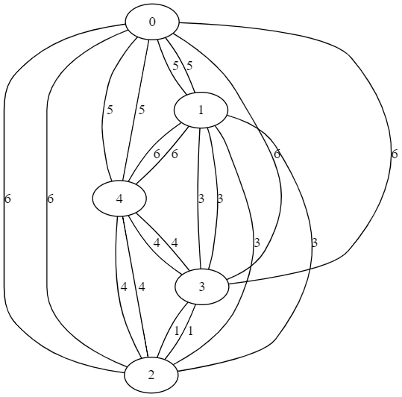
GRAPH REPRESENTATION
From location 0 to location 1, duration of 5 minutes
From location 1 to location 0, duration of 5 minutes (so symmetry)
From location 0 to location 0, duration of 0 minutes (reflexivity)
ANALYSIS
Transitivity in our case means that if we have (i,j) and (j,k), we should also have (i,k). In our graph, this principle explains why (0,3) = 6 despite the absence of direct binary relations.
that’s why (i,j) + (j,k) != (i,k) in many cases
output of .dot file using our matrix (reduced to 5 states for visibility)
(link to full graph)
‹#›
Antonin Winterstein - Killian Maxel | MSC project | Master IoT 2023-2024
15

Slide 10
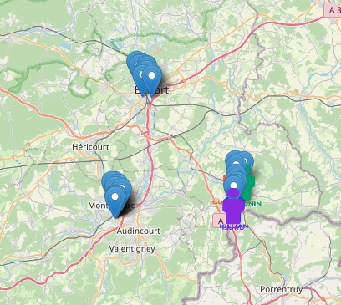
IMPLEMENTATION

Slide 11
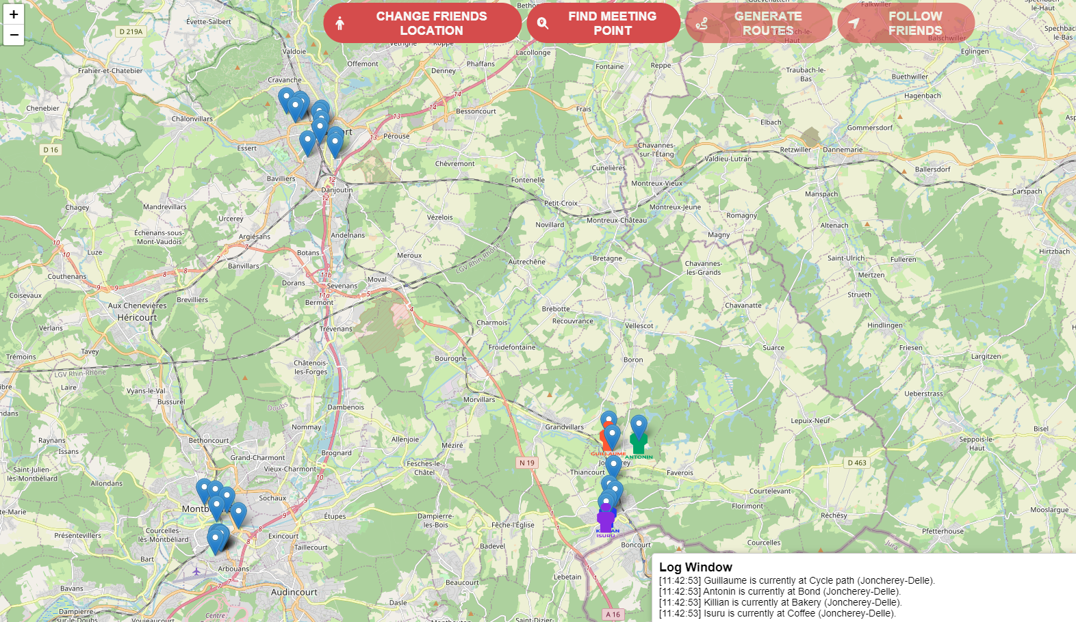
INTERFACE
RESULT
‹#›
Antonin Winterstein - Killian Maxel | MSC project | Master IoT 2023-2024
15

Slide 12
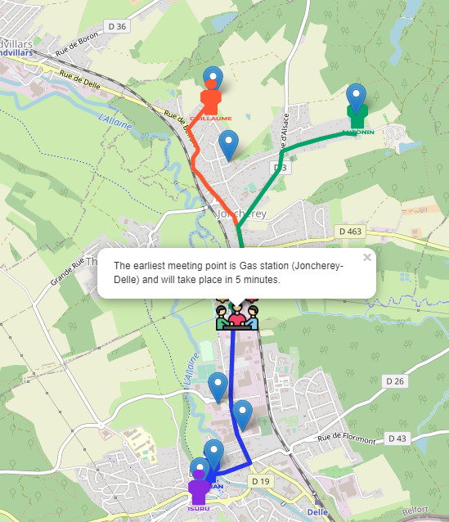
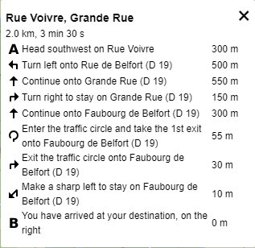
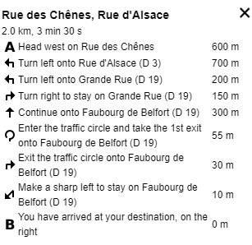
GENERATED ROUTES
RESULT
Routes generated for friends to join the meeting point elected
‹#›
Antonin Winterstein - Killian Maxel | MSC project | Master IoT 2023-2024
15

Slide 13
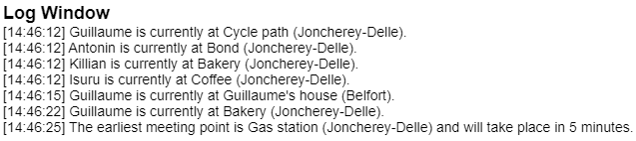
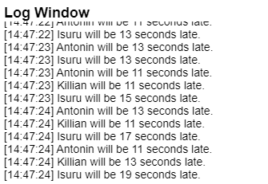
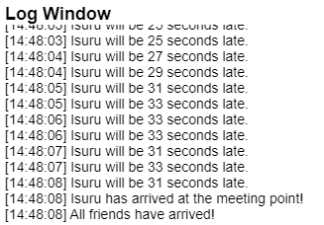
Logs concerning friends (late, early, arrived, etc.)
TRACKING
RESULT
‹#›
Antonin Winterstein - Killian Maxel | MSC project | Master IoT 2023-2024
15

Slide 14

CONCLUSION

Slide 15
FUTURE
What’s next?
CONCLUSION
Adding friends / locations / OD matrices
Taking into account ways of transport
Add a feature to allow the user to add or remove new friends or locations
Would help the user customize depending on his own need
Give more flexibility
Currently only based on time travel with car
Could take into account other means like bus, bicycle, train, walking…
Allow the user to select what transport mean he wants
Adapt the travel using several means at once
Improving the tracking
Include real-time data like traffic information, weather conditions or public transportation schedules
Instead of relying on static data, consider integrating real-time data sources for tracking, like GPS data from mobile devices.
14
Antonin Winterstein - Killian Maxel | MSC project | Master IoT 2023-2024
15

Slide 16

THANK YOU FOR YOUR ATTENTION
DO YOU HAVE ANY QUESTION?

